Slide 1
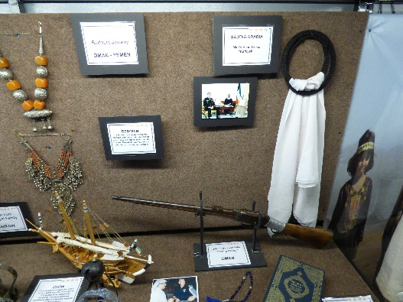
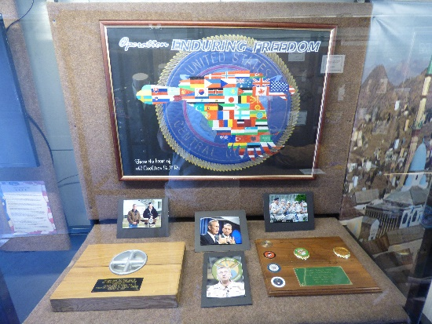
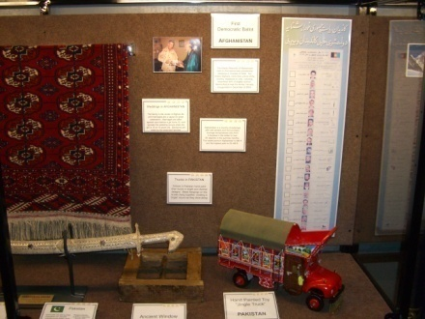
GENERAL TOMMY FRANKS
ROAD SHOW & CLASSROOM
GUIDE FOR TEACHERS AND EDUCATORS

Slide 2
PO Box 222
507 South Main
Hobart, Oklahoma 73651
Phone: 580-726-5900
Fax: 580-726-5901
admin@tommyfranksmuseum.org
Dear Educator,
First, permit us to thank you for your contribution to America’s future generation. Our children are our most prized treasure, and your contribution to their education sincerely appreciated.
We hope the Traveling Road Show will assist you in broadening your teaching resources. Our aim is to stimulate young minds to want to learn by exposing them to artifacts and exhibits seldom encountered in every day life in America. If the experience encourages one child to want to learn, we have accomplished our objective.
In the attached documents, you will find the correlation of National Standards, Oklahoma Priority Academic Student Skills for Grades 6 and 7 and Texas 6th grade. The purpose of the correlation is to assist in linking Road Show displays with education objectives taught on the respective material of social studies, history, geography, art and culture. Included in the packet are examples of lesson plans which may be used to stimulate learning both prior to our visit and after.
If there is anything we can do to make the Road Show experience more helpful please let us know.
Respectfully,
D’Lese Travis, Executive Director
General Tommy Franks Leadership Institute and Museum

Slide 3
CONTENTS
About the Road Show
Who is General Tommy Franks
Explanation of Exhibits & Items
Sample questions and pronunciations
Terms and definitions
Seek and find game
Lesson Worksheet

Slide 4
ABOUT THE GENERAL TOMMY FRANKS LEADERSHIP
INSTITUTE AND MUSEUM ROAD SHOW
WHAT IS THE ROAD SHOW?
The General Tommy Franks Leadership Institute and Museum has a 60 foot truck and trailer. This traveling exhibit showcases our artifacts from countries such as Egypt, Jordan and the “stan” lands. It introduces everyone to different countries, cultures and religious diversity.
HOW TO SCHEDULE THE ROAD SHOW?
Scheduling the Road Show is easy, call us at 580-726-5900 or visit our website at tommyfranksmuseum.org. The Road Show is scheduled on first come, first serve basis “FREE TO ALL SCHOOLS” in a four state area.
Once a date is established, we will email our curriculum packet to you so you may begin to prepare the students for our visit. Our packet includes descriptions and pictures of the items on display in the road show. Also included are sample questions and answer sheets, a seek and find game, and a suggestion for a class project A lesson plan is included for your convenience.
WHAT TO EXPECT UPON OUR ARRIVAL
Our driver and educator will arrive 1 hour before the first class begins. They will position the mobile classroom at the predetermined location. Our self contained trailer is ADA compliant with ramps for wheelchairs.
Your students will report to their regular class. There they will be divided up into groups of 10 to 15 for the mobile classroom. This will allow each group 15 to 20 minutes per tour. The educator will explain the significance and use of terms in the exhibits, followed by questions and answers to complete the tour.
.
4

Slide 5
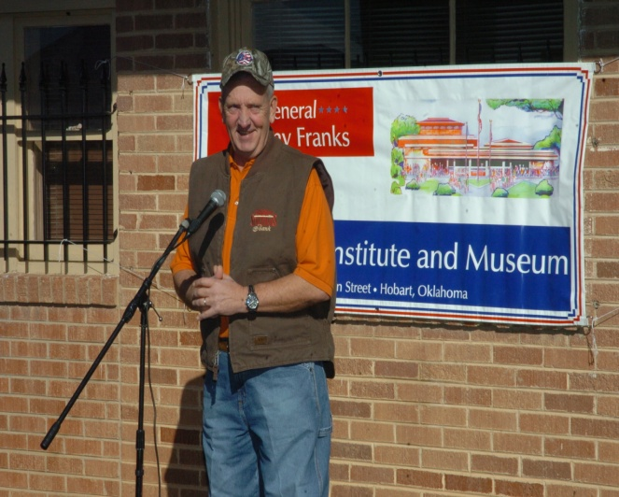
General Tommy Franks (ret.)
Tommy Franks was born in Wynnewood, Oklahoma and grew up in
Midland, Texas. After two years at the University of Texas, he joined the United States Army as a Private and in 1967 was commissioned a Second Lieutenant.
His service in Vietnam earned him six awards for Valor and three Purple Hearts. That assignment was the start of a long and distinguished career that would take him from one world hot spot to another – from West Germany at the height of the Cold War to the Demilitarized Zone in Korea, to the deserts of Arabia.
General Franks graduated from the University of Texas at Arlington with a Bachelors Degree in Business Administration, and Shippensburg University, Pennsylvania, with a Masters Degree in Public Administration. He is a member of Alpha Chi National Honor Society and Omicron Delta Epsilon Honor Society for Economics.
In June 2000, he was promoted to four-star General and assigned as Commander-in-Chief, United States Central Command where he led American and Coalition Troops in Operation Enduring Freedom in Afghanistan and Operation Iraqi Freedom in Iraq.
The General’s awards include five Distinguished Service Medals, four Legions of Merit and five Bronze Stars. He was appointed Knight Commander of the Order of the British Empire (KBE) by order of Her Majesty Queen Elizabeth II on May 25, 2004. President George W. Bush awarded him the Nation’s highest civilian award, The Presidential Medal of Freedom on December 14, 2004. General Franks has received honorary degrees from a number of universities including his alma mater, Shippensburg University and his wife’s alma mater, Oklahoma State University.
The General’s wife, Cathryn Carley Franks, is a professional educator with degrees from Oklahoma State University and The George Washington University. They currently live on a family ranch near Roosevelt, Oklahoma.
5

Slide 6
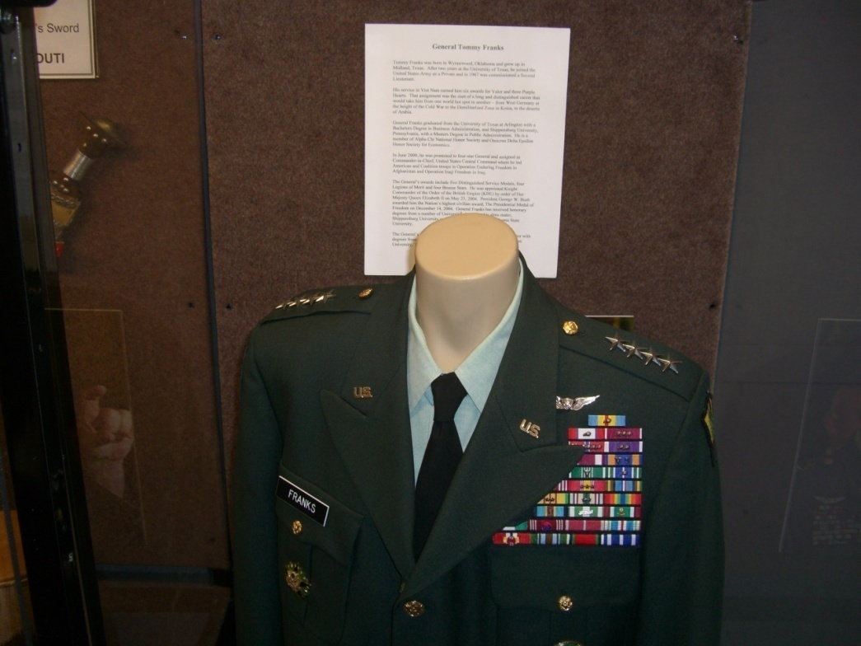
General Tommy Franks Display Case
Display Case L5
General Franks’ Dress Uniform
Uniform of a 4 star general in the United States Army with biographical information
and photo.
Oklahoma Priority Academic Student Skills
Correlation to World Studies, Grade 6 in Red
Correlation to World Geography, Grade 7 in Blue
1.1
3.1
3.2
1.1
Right Shoulder Epaulet
Rank-4 Star General
Left Shoulder Epaulet
Rank-4 Star General
1
22
33
2
3
Right Shoulder Patch
(Combat Patch)
1st Cavalry Division
4
5
Left Shoulder Patch
(Last Unit Assigned)
US Central Command
6
7
8
9
10
11
12
Army Aviation Badge
(Wings)
13
14
15
16
17
18
19
20
21
22
23
24
25
26
Right Pocket-Army Staff
Identification Badge
Left Pocket
US Central Command Badge
Ribbons-See Below
Defense Distinguished Service Medal-3 awards 14. Southwest Asia Service Ribbon
Distinguished Service Medal-2 awards 15. Army Service Ribbon
Legion of Merit-4 awards 16. Army Overseas Service Ribbon
Bronze Star-5 awards 17. Republic of Vietnam Campaign Medal
Purple Heart-3 awards 18. Kuwait Liberation Medal (Government of Saudi Arabia)
Meritorious Service Medal 19. Kuwait Liberation Medal (Government of Kuwait)
Air Medal-9 awards 20. Order National Security Merit Cheonsu Medal (Republic of Korea)
Army Commendation Medal-2awards 21. Knight Commander of the British Empire (England)
Army Achievement Medal 22. Ordre National Du June 1977 (Djibouti)
Army Good Conduct Medal 23. Military Medal of 1st Order (Bahrain)
National Defense Service Medal 24. Minister of Defense Kyrgyz Republic Outstanding Military Service (Kyrgyzstan)
Armed Forces Expeditionary Medal
Vietnam Service Medal 25. Emirates Military Medal (United Arab Emirates)
26. Sash of Kuwait (Kuwait)
6

Slide 7
Display Case R6 World Map
This exhibit includes an interactive World Map on IPAD. Students can experience
General Franks travels throughout the Area of Responsibility of Central Command.
Countries displayed have information regarding land area, population, climate,
natural resources and other cultural facts.
1.1
1.3
2.4
1.1
2.1
4.1
Eritrea
United Arab Emirates
Yemen
Oman
Bahrain
Qatar
Kuwait
Saudi Arabia
Djibouti
Kenya
Sudan
Ethiopia
Afghanistan
Pakistan
Egypt
Jordan
Petra
Kazakhstan
Kyrgyzstan
Turkmenistan
Uzbekistan
Tajikistan
Iran
Iraq
Seychelles
7

Slide 8
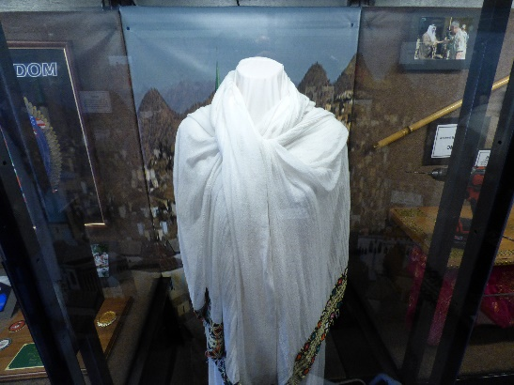
Display Case R5 Woman’s Clothing, Eritrea
A traditional Cotton Dress, typical of dresses in East Africa worn for special occasions. Cotton is a local product.
1.3
3.1
3.2
1.1
2.1
4.1
ERITREA
Location: Is located in the Horn of
Africa in East Africa. It is bordered to
the northeast and east by the Red Sea,
Sudan to the west, Ethiopia to the south,
and Djibouti to the southeast.
Capital – Asmara
Language – Tigrinya, Arabic, English
Land Area – 45,400 square miles
Population – 5,869,869 (2016)
Resources – Copper, gold, granite,
marble and potash
80% of the Eritrean workforce are
employed in agriculture
Literacy Rate for the total population is 81%.
Religion – 50% Christianity, 48% Islam, 2% Other
*POTASH – is any various mined and manufactured salts that contain potassium in
water-soluble form.
8

Slide 9
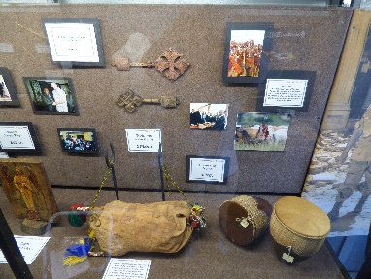
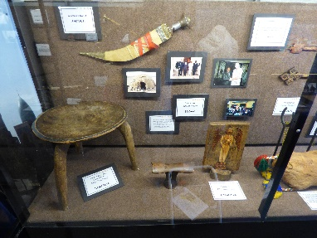
Display Case L4 Artifacts from East Africa
Bushman’s Sword, Ceremonial Drums, Traditional Water Carrier
and African Wall Art
1.1, 3.1, 3.2
4.1, 4.2
2.1
2.2
4.1
KENYA
Location: lies on the equator and overlies the East African Rft and further south-east to the Indian Ocean
Capital: Nairobi
Language: English – Kiswahili
Land Area: 224,445sq mi
Population: 48,655,760
Resources: tea, coffee, horticultural products, oil, cement, fish
75% of the workforce are agricultural
38.5% of the population is illiterate
Religion: 83% Christians, 11.2% Islam
DJIBOUTI
Location: Horn of Africa, bordered by Eritrea in the north and Ethiopia in the west and south
Capital: Djibouti City
Language: French-Arabic
Land Area: 9,000sq mi
Population: 2016 estimate
846,687
Resources: gold, clay, granite, marble
79.7% employment in the service sector
Literacy Rate: 70%
Religion: 94% Islam
Much of the population of Africa is found in rural areas, both in the jungles and deserts. Most of their utensils and furnishings are hand made. The wooden stool and goat skin water carrier are examples of items used every day.
Masai – For the Masai tribe of eastern Africa life revolves around cattle. Social roles and status derive from the relationship of people to their cattle. Children work equally with adults to care for the cattle.
A common personal item found across the Continent of Africa is the headrest or “pillow” made of wood. People who frequently sleep on the ground use the “wood pillow” to elevate their heads in order to avoid problems with bothersome insects.
Coptic Christianity - The Coptic Orthodox Church of Alexandria is an Oriental Orthodox Christian church based in Egypt, Northeast Africa and the Middle East. The head of the Church and the See of Alexandria is the Patriarch of Alexandria on the Holy See of Saint Mark, who also carries the title of Coptic Pope.
SUDAN
Location: bordered by Egypt to the north, the Red Sea and Eritrea.
Capital: Khartoum
Language: Arabic, English
Land Area: 728,215sq mi
Population as of 2015,
40,235,000
Resources: Oil
80% of the workforce are agricultural
Literacy: 70.2% of total population, male 79.6%
Female 60.8%
Religion: 97% Islam
ETHIOPIA
Location: Horn of Africa and borders Eritrea
Capital: Addis Ababa
Language: Various Tribal
Land Area: 426,400sq mi
Population: 2017estimate
102,374,044
Resources: Coffee and Water
85% of the workforce are agricultural
Literacy: 46.7%
Religion: 62.8% Christians, 43.5% Ethiopian Orthodox – Coptic Christianity, 33.9% Muslim
9

Slide 10
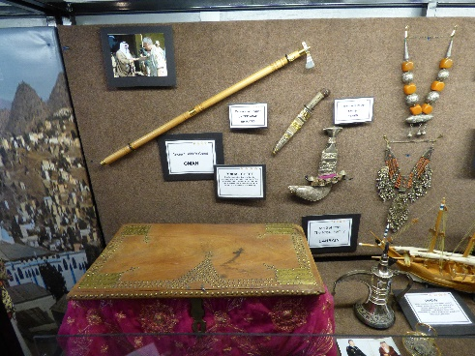
Display Case R4 Artifacts from the Arabian Peninsula
Ancient Brides Chest, Bedouin Rifle, Bedouin Jewelry, Ceremonial Dagger, Tea Set,
Falcon Hood, Dhow, Man’s Head Dress “Kaffiyeh”, Prayer Beads and Quran
1.1, 3.1, 3.2
3.3, 4.1, 4.2
1.1
2.1
2.4
4.1
Falcon Hunting
Falcon hunting is a major sport among Arabs. Carefully trained falcons, rather than guns, are used to hunt birds, small ground animals and in some cases larger animals, such as antelope.
Bridal Chest
Chests containing a dowry or gifts often accompany a bride to her new home. The dowry is money or other goods that a bride’s family gives to the bridegroom or his family at the time of the wedding.
Bedouin
The Bedouin are Arabic speaking nomads who have maintained their pastoral way of life over thousands of years. Desert Bedouin survive on their herds of sheep and camels.
Dhow
Large wooden boats have been used in Arabian waters since the 17th Century for fishing, pearl diving and general commerce. The largest dhow was completed in 2000 in Kuwait and weighs an estimated 2,500 tons.
Bedouin Jewelry
Bedouin Jewelry is common throughout the Middle East, and is usually made of silver. Jewelry is often part of a bride’s dowry.
10

Slide 11
Case R4
Countries of the Arabian Peninsula
UNITED ARAB EMIRATES
Location: Western Asia at the southeast end
of the Arabian Peninsula on the Persian Gulf
Capital: Abu Dhabi
Language: Arabic
Land Area: 32,300 sq mi
Population: 2017 estimate 9,400,000
Resources: Oil & natural gas
Literacy: 90%
Religion: Islam
QATAR
Location: peninsula on the northeastern
Coast of the Arabian Peninsula
Capital: Doha
Language: Arabic
Land Area: 4,471 sq mi
Population: 2016 estimate
2,675,522
Resources: Oil
Illiteracy rate in Qatar was 3.1% for males
and 4.2% for females in 2012
Religion: Islam
YEMEN
Location: Arabian Peninsula
Capital: Sana’a
Language: Arabic
Land Area: 203,850 sq mi
Population: 25,408,000
Resources: Oil & Natural Gas
Literacy: 64%
Religion: Islam
KUWAIT
Location: Northern edge of Eastern Arabia at the tip of the Persian Gulf
Capital: Kuwait City
Language: Arabic, English
Land Area: 6,880 sq mi
Population: 2016 estimate
4,348,395
Resources: Oil
Kuwait has the highest literacy rate in the Arab World.
Religion: Islam
OMAN
Location: Southeastern coast of the
Arabian Peninsula
Capital: Muscat
Language: Arabic
Land Area: 119,500 sq mi
Population: 2017 estimate
4,748,417
Resources: Oil & Natural Gas
Literacy: 86.9%
Religion: Islam
SAUDI ARABIA
Location: a Arab sovereign state in
Western Asia constituting the bulk of the Arabian Peninsula
Capital: Riyadh
Language: Arabic
Land Area: 830,000 sq mi
Population: 2017 estimate
33,000,000
Resources: Oil
Literacy: 90.4% among males and 81.3% among females
Religion: Sunni Islam
BAHRAIN
Location: an island country consisting of a
small archipelago centered around Bahrain
Island
Capital: Manama
Language: Arabic
Land Area: 295 Sq mi
Population: 2016 estimate
1,378,000
Resources: Oil
Literacy: estimated to be 90%
Religion: Islam
11

Slide 12
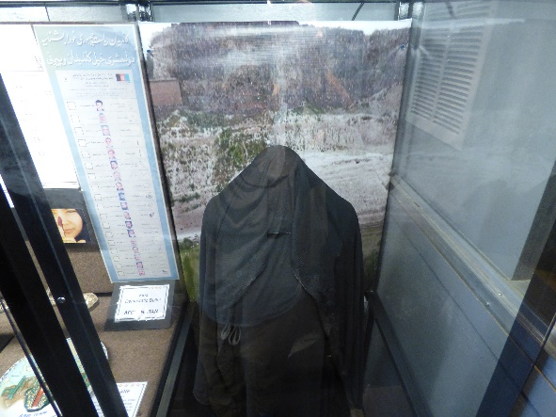
Display Case R1 Woman’s Clothing, Saudi Arabia
ABAYA
Traditionally a long black cloak, usually paired with the hijab (headscarf) or niqab (slit for the eyes) Islamic law or Sharia Law is practiced in Saudi Arabia. Saudi Arabia imposes a dress code for public on women. Women in Saudi Arabia need to be covered from head to toe if you are a Islamic woman. The strict dress code still leaves room for personal taste like different cuts, colors, styles, fabrics and colors.
3.1
3.2
1.1
2.1
12

Slide 13
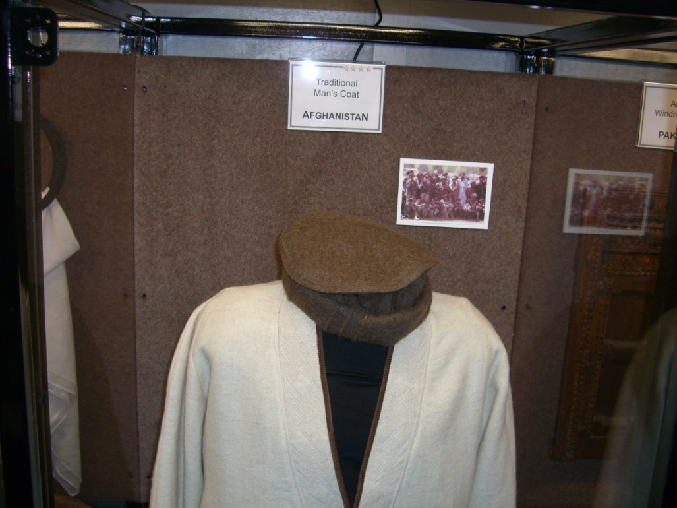
Display Case R3 Man’s Clothing, Afghanistan
Traditional man’s Wool Coat and Hat. Wool is a local product.
1.1
3.1
3.2
1.1
4.1
Afghanistan is a country of extremes with cold winters and hot summers. Average temperatures vary from 5 degrees in the winter to over 95 degrees in the summer months. The lowest point in Afghanistan is 846 ft and the highest point is 24,446 ft.
Weddings in Afghanistan
The family is the center of Afghan life and marriages are a cause for great celebration. Marriages are often agreed upon before a girl turns 10, and typically the wedding occurs when the girl is 15 or 16 years old. Decisions
are made by the extended families.
13

Slide 14
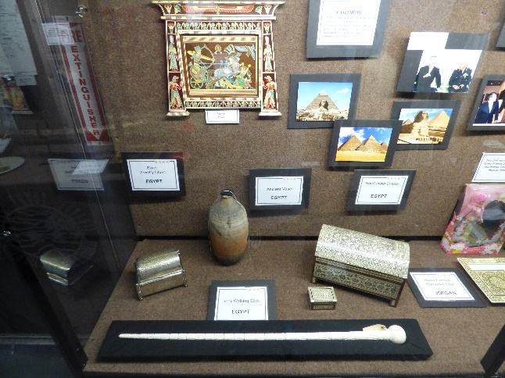
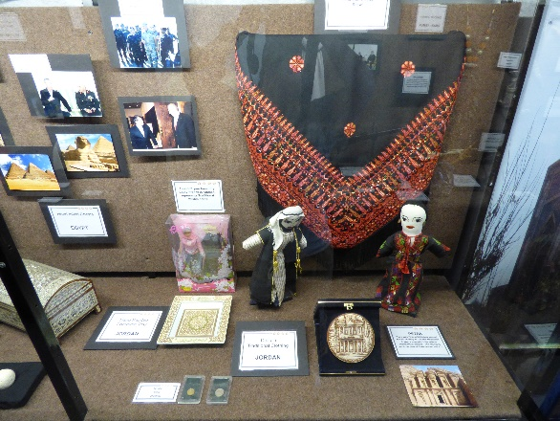
Display Case L2 Artifacts from Egypt and Jordan
Embroidered Shawl, Porcelain Trays, Tribal Dolls, Ancient Vase, Silver Chest,
Ivory Walking Stick, Inlayed Chests, Plate from Petra
1.1, 3.1
3.2, 3.3
1.1
2.1
EGYPT
Location: Northeast corner of Africa
Capital: Cairo
Language: Arabic
Land Area: 390,120.66 sq mi
Population: 2017 estimate
93,794,000
Resources: coal, oil, natural gas, hydro power
Literacy: 73.9%
Religion: 90% Islam, Sunni
JORDAN
Location: Arab Kingdom in Western Asia
Capital: Amman
Language: Arabic
Land Area: 34,495 sq mi
Population: 2017 estimate
9,952,293
Resources: Oil, phosphate mines, uranium
Literacy: 95.4$
Religion: 92% Islam, Sunni
Pyramids
In Ancient Egypt pyramids were usually built as tombs for the Pharoahs, the rulers of Egypt. Most Pyramids are near the city of Cairo, the capital of Egypt, and were built between 2600 B.C. and 1800 B.C.
Petra
Petra was first established around the 7th Century B.C. by the Nabatean Arabs, a nomadic tribe with a commercial empire. It was carved out of a solid rock canyon. The Romans took control of Petra about 100 A.D.
14

Slide 15
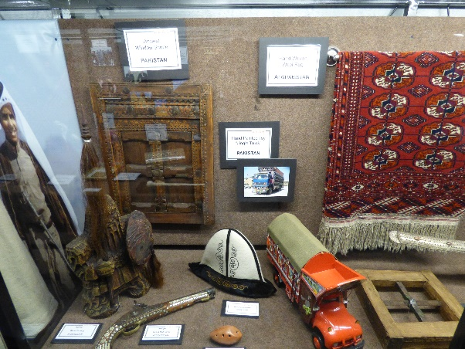
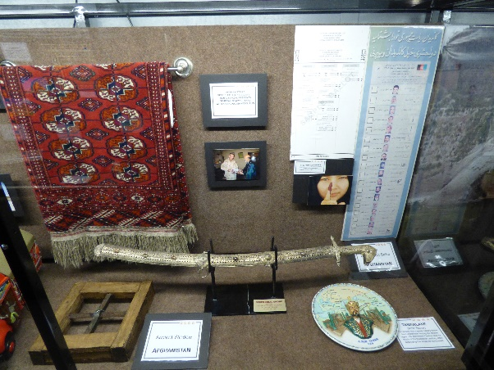
Display Case R2 Artifacts from Central Asia
Window Shutter, Window, Ceremonial Sword, Jingle Truck, Antique Cap & Ball Pistol,
Hand Woven Rug, first Afghanistan democratic Presidential Ballot
1.1, 3.1
3.2, 4.1
1.1
2.1
AFGHANISTAN
Location: a landlocked country located within South Asia and Central Asia.
Capital: Kabul
Language: Pashto & Dari
Land Area: 252,000 sq mi
Population: 2016 estimate
33,332,025
Resources: coal, copper, iron ore, lithium, uranium, gold, zinc, natural gas and oil.
Literacy: 38.2%
Religion: 99% Sunni Islam
PAKISTAN
Location: South Asia and on junction of West Asia, Central Asia and East Asia
Capital: Islamabad
Language: Urdu & English
Land Area: 340,509 sq mi
Population: 2017 Census
207,774,520
Resources: Oil, Natural gas, nuclear energy
Literacy: 58%
Religion: 96.4% Sunni Islam
Pakistan became a nation in 1947 when British India was split into the Muslim state of Pakistan and the primarily Hindu state of India.
Drivers in Pakistan hand paint their trucks in bright and diverse designs. Metal hangings on the trucks clang together, creating a “jingle” sound as they drive along.
15

Slide 16
Display Case R2 Artifacts from Central Asia
Man’s Ceremonial Hat, Warrior Wood Carving, Hand Carved Flute, Amir Temur (Tamarlane) Plate
1.1 3.1
3.2
1.1
2.1
KYRGYSTAN
Location: bordered by Kazakhstan to the north, Uzbekistan to the west and southwest, Tajikistan to the southwest and China to the east.
Capital: Bishkek
Language: Kyrgyz & Russian
Land Area: 77,202 sq mi
Population: 2016 estimate
6,019,480
Resources: coal, gold, uranium, antimony
Education: To graduate, a student must complete the 11-year school course and pass 4 mandatory state exams in writing, math, history and a foreign language
Religion: 80% Islam, 17% Russian Orthodox Church.
UZBEKISTAN
Location: is one of only two doubly landlocked countries in the world.
Capital: Tashkent
Language: Uzbek, Russian
Land Area: 173,351 sq mi
Population: 32,979,000
Resources: cotton, gold, uranium and natural gas
Literacy: 99.3$
Religion: 88% Sunni Islam
KAZAKHSTAN
Location: is the world’s largest landlocked country in Central Asia
Capital: Astana
Language: Kazakh, Russian
Land Area: 1,052,100 sq mi
Population: 18,050,488
Resources: Oil, natural gas, uranium, chromium, lead, zinc and diamonds
Literacy: 99.5%
Religion: 70.4% Islam, 24.7% Christianity
TURKMENISTAN
Location: bordered by Kazakhstan to the northwest, Afghanistan to the southeast
Capital: Ashgabat
Language: Turkmen
Land Area: 189,660 sq mi
Population: 5,171,943
Resources: Oil, Natural gas
Education: Mandatory education for 10 years
Religion: 89% Islam, 10% Christianity
Kazakhstan
In the past ethnic Kazakhs lived in YURTS, portable tents of felt, which were easily moved from place to place. Today most of the people live in cities and villages. They commonly eat horsemeat and drink mare’s milk.
Tamarlane (Amir Temur)
Tamarlane was a great military leader from Uzbekistan during the Middle Ages. He dominated Central Asia for much of the fourteenth century, often destroying areas he conquered.
16

Slide 17
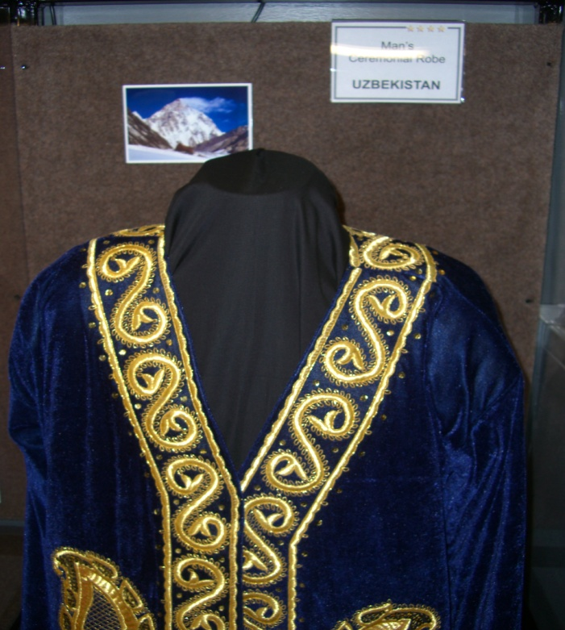
Display Case L3 Man’s Clothing, Uzbekistan
Man’s Ceremonial Robe, heavy ornamentation typical of Central Asia.
1.1
3.1
3.2
1.1
17

Slide 18
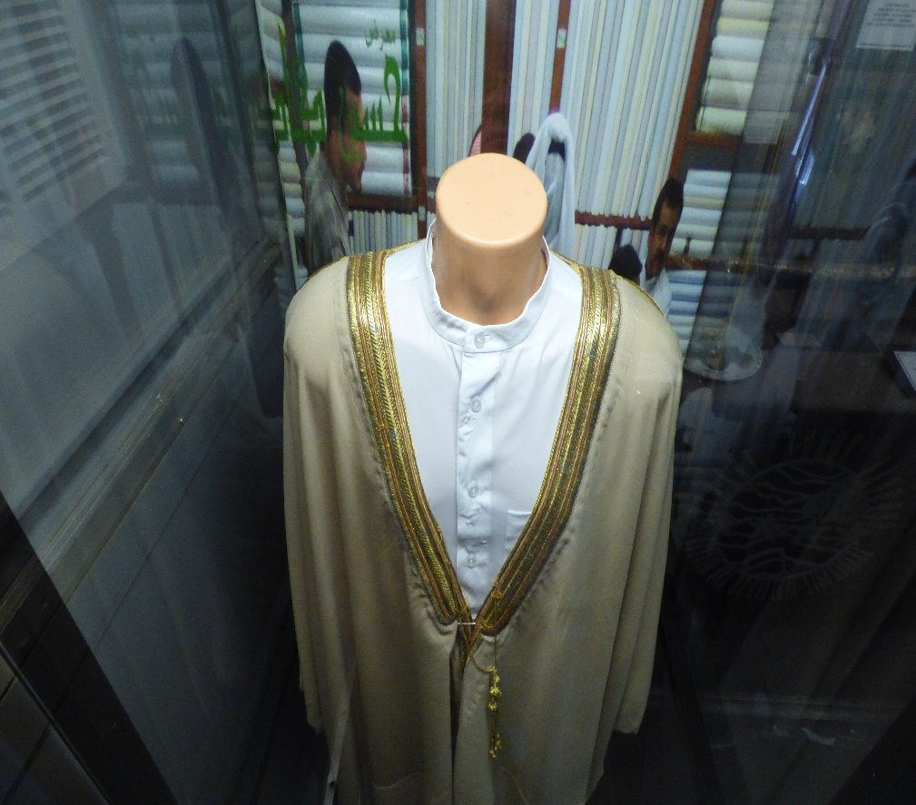
Display Case L1 Man’s Traditional Middle Eastern Clothing
1.1 1.1
3.1
3.2
Thobe is a male’s outer long robe like garment that is traditional wear in Middle Eastern Countries and other muslim cultures. They range from a casual look to a more professional business dress attire. Usually worn with white undershirt or pants.
18

